Slide 1
Physics of Data Lab: Projects
Spring 2024
Dr. Jeff M. Byers
jmbyers101010@gmail.com

Slide 2
Physics of Data Lab Group Project
Objective: Study the Machine Learning Transformer architecture from the perspective of Complex Dynamical Systems theory and high-dimensional geometry.
What you will learn: Dynamical Systems Theory, Approximate Nearest Neighbor Search, Kernel Density Estimation, High-dimensional Geometry, Statistical estimation of Differential Geometric measures, ML embedding spaces, Transformer architecture and Large Language Models.
Challenges: Applicability of Dynamical Systems to Transformers is a cutting-edge research concept with uncertain efficacy. Analysis of ML embedding spaces with geometric statistics can be difficult due to the high dimensions (D=10³ to 10⁴).
My job is to support your understanding, provide background lectures and proto-type code for use in the project.
Team structure:
Approximate Nearest-Neighbor (ANN) Search
High-dimensional Geometry
Adaptive Kernel Density Estimation (KDE)
Data Generation
LLM Experimentation
Transformer Dynamics
Theory/Algorithm oriented …
Code oriented …

Slide 3
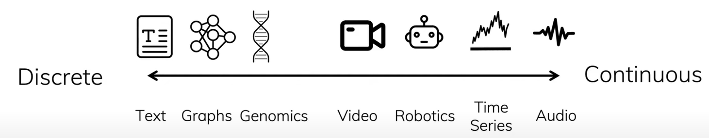
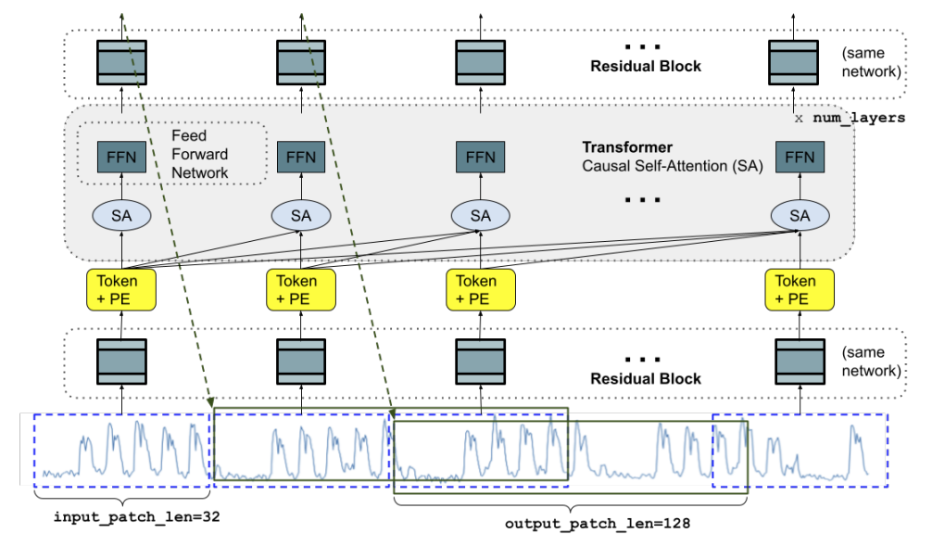
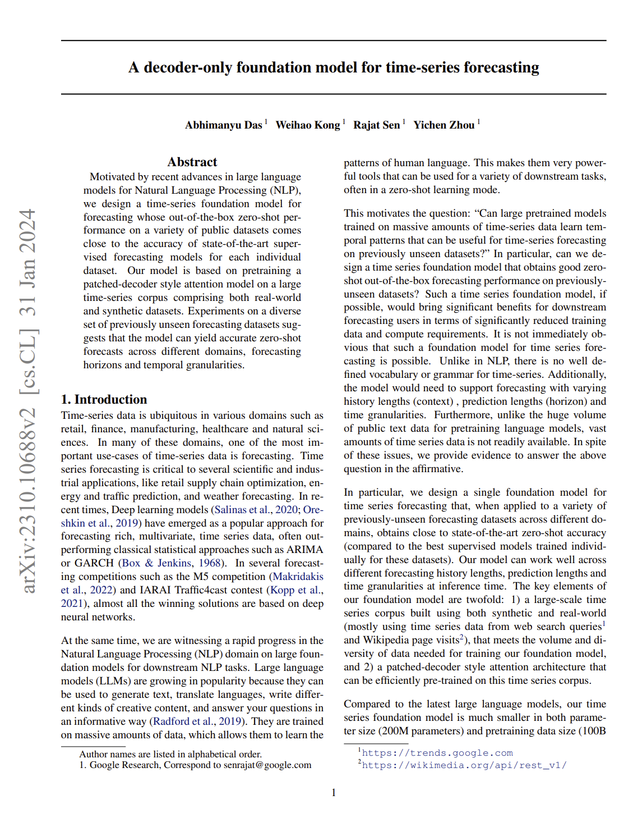
Transformers for Time-Series Data

Slide 4
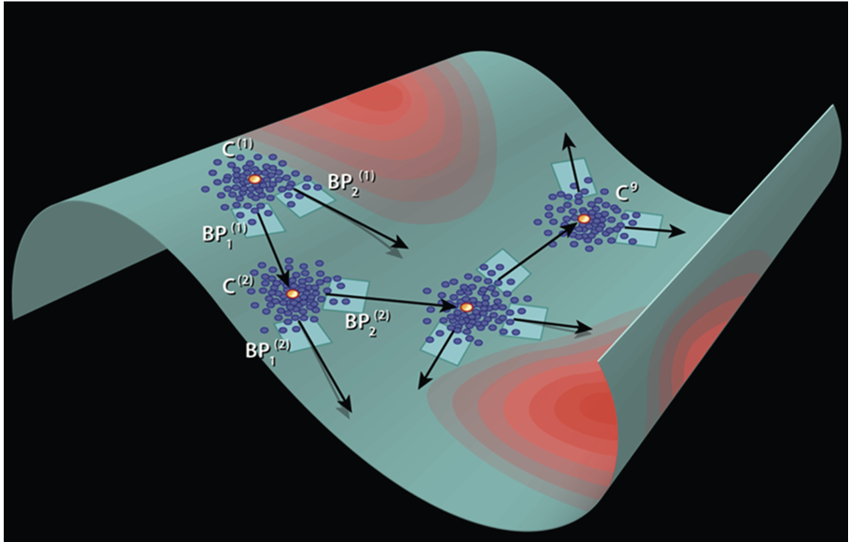
State-Space Models (SSM) for Sequence Analysis
Geometric perspective: Families of vector fields on a Manifold, M, that form a basis for the Tangent space, T_{p}M
Linearization:
Linearization on Local Tangent Space, T_{p}M
Integral curves parameterized by t
Discretization:
Only useful if A is not time-dependent.
Time-evolution operator of the state, x

Slide 5
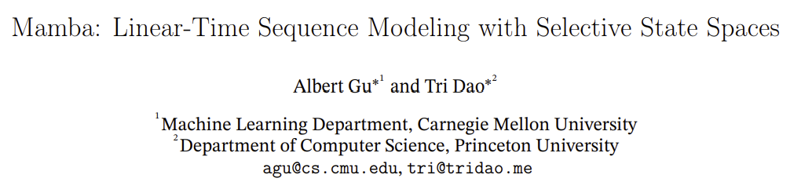
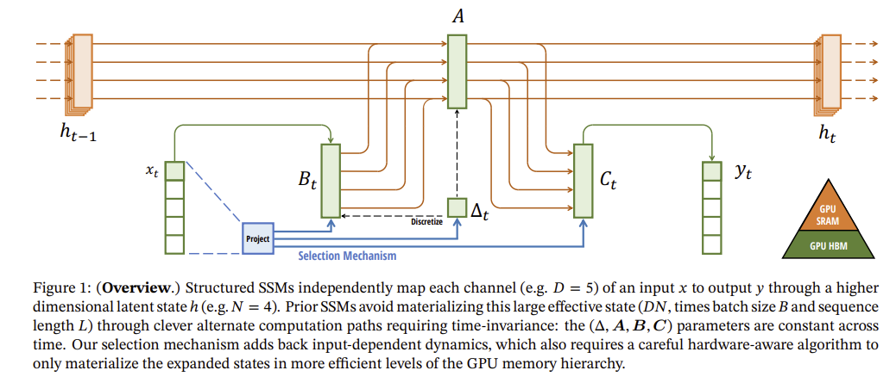
State-Space Models (SSM) for Sequence Analysis
Geometric perspective: Families of vector fields on a Manifold, M, that form a basis for the Tangent space, T_{p}M
Linearization:
Linearization on Local Tangent Space, T_{p}M
Integral curves parameterized by t
Discretization:
Only useful if A is not time-dependent.
Time-evolution operator of the state, x

Slide 6
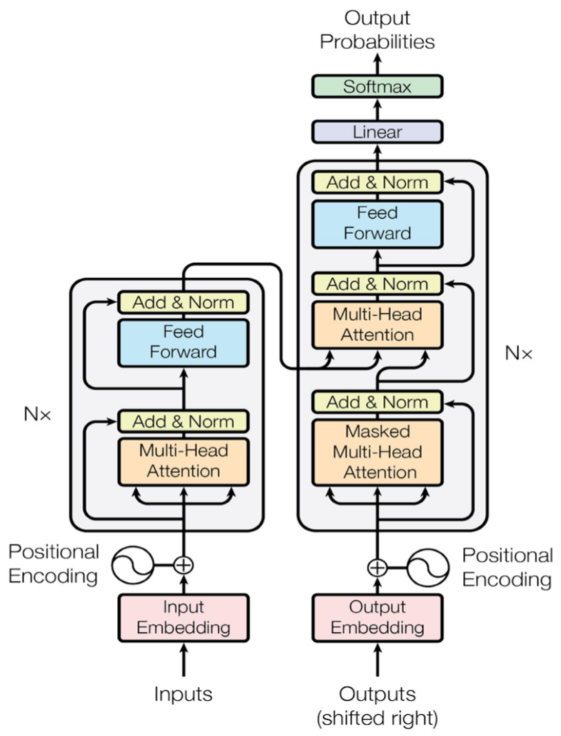
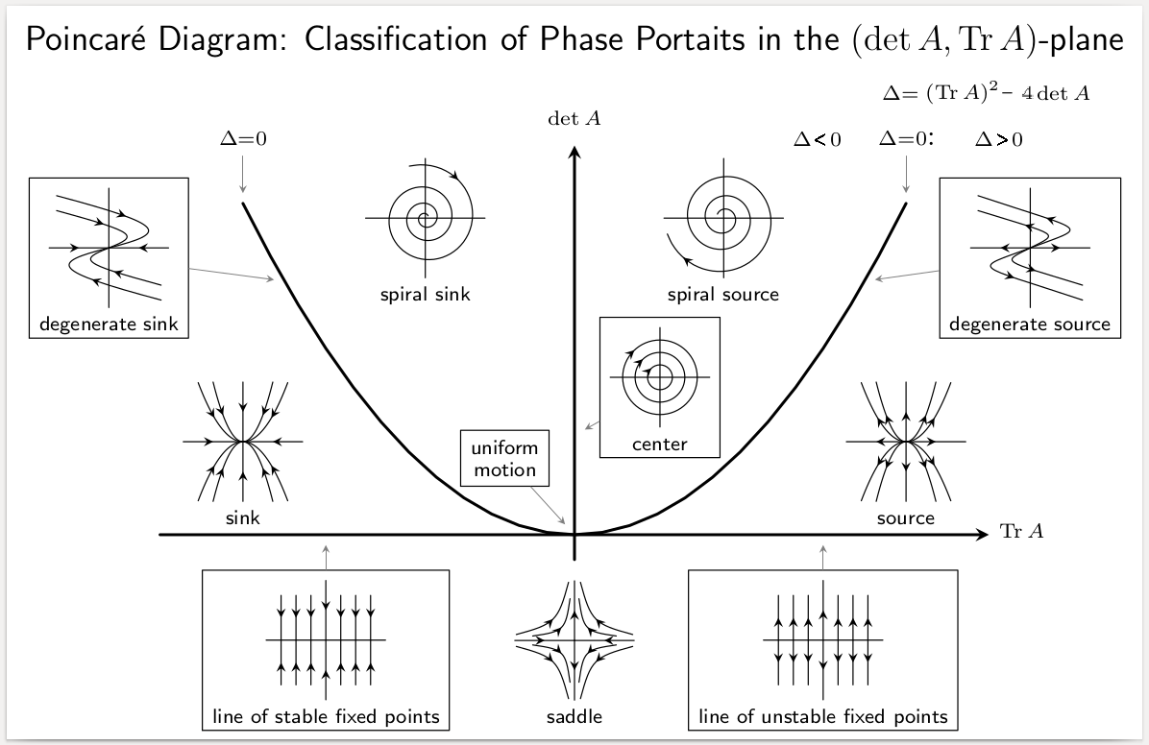
Complex Dynamical Systems and Transformers
High-Dimensional Complex Dynamical System
Quasi-probabilistic state transition
Local Tangent Model
Learned Stochastic Model
Form Hankel matrix and examine SVD
Embedding
Layer
Observations from a Complex Dynamical System
Notes:
Hankel matrices are formed when, given a sequence of output data, a realization of an underlying state-space or hidden Markov model is desired.^{[3]} The singular value decomposition (SVD) of the Hankel matrix provides a means of computing the A, B, and C matrices which define the state-space realization.^{[4]} The Hankel matrix formed from the signal has been found useful for decomposition of non-stationary signals and time-frequency representation.

Slide 7
Complex Dynamical Systems and Transformers
High-Dimensional Complex Dynamical System
Quasi-probabilistic state transition
Local Tangent Model
Learned Stochastic Model
Technical Approach #1: Formulate a basic Transformer from scratch and train/predict on dynamical systems.
Technical Approach #2: Train a basic Transformer on a small text database and study the geometry of the embedding space.
Technical Approach #3: Use a pre-trained Transformer (Meta’s Llama, Google’s Gemma) that functions as a ChatBot and study it as a high-dimensional dynamical system.
Form Hankel matrix and examine SVD
Embedding
Layer
Observations from a Complex Dynamical System
Notes:
Hankel matrices are formed when, given a sequence of output data, a realization of an underlying state-space or hidden Markov model is desired.^{[3]} The singular value decomposition (SVD) of the Hankel matrix provides a means of computing the A, B, and C matrices which define the state-space realization.^{[4]} The Hankel matrix formed from the signal has been found useful for decomposition of non-stationary signals and time-frequency representation.

Slide 8
Attention: Query, Keys, Values … and Causality?
The Masked Self-Attention mechanism is how a database engineer would build an Auto-Regressive signal processing algorithm!
Database Engineering Perspective:
In database systems, the interaction between queries, keys, and values is fundamental. A query is used to retrieve information (values) based on certain criteria (keys). This process is highly structured and relies on efficient indexing and retrieval mechanisms to access relevant information quickly and accurately.
Machine Learning/Attention Mechanism: The attention mechanism, particularly in the context of autoregressive models (AR) like GPT, uses queries, keys, and values to dynamically weigh and retrieve information from different parts of the input sequence to generate each part of the output sequence. This process bears a resemblance to database retrieval (queries and keys) but is applied to the sequential prediction task typical of signal processing.
Signal Processing Perspective:
Traditional autoregressive (AR) models in signal processing predict future signals based on past observations. These models are inherently sequential and rely on the mathematical properties of the signals (e.g., time series data) to model and forecast future values.

Slide 9





Transformers and the Attention Mechanism
Input sequence:
It is hard to understand … Transformer.
y_{t+1}
Attention Layer Settings
Tokenized sequence:
Self
Cross
ENCODER
Single Head
Multi-Head
Embedded sequence:
K
V
DECODER
Un-Masked
Masked
(if Self selected)
The purpose of the Attention mechanism is to connect a Query to relevant Values by using the structural organization imposed by the Keys. The Keys are a basis onto which a Query is linearly projected. Values are the data instances organized by the Keys.
Q
NOTES:
Cross-Attention only happens when DECODER’s sequence is assigned its attention using the shares the Keys and Values acquired from a second sequence by the ENCODER and its linear projection matrices, W.
Masked Attention only happens in the DECODER so that relationships within the sequence are causal during self-attention and is not possible for cross-attention. The masking assigns negative infinity to the upper triangular portion of the QK^{T} matrix prior to softmax normalization so as to zero out those entries in A.
A, Attention Score (AS) matrix
Softmax normalization along the rows of A matrix
u
y_{t}
u
GPT is a DECODER ONLY architecture and does NOT use Cross-Attention. Instead, Masked Self-Attention is used at every layer to enforce causal structure.

Slide 10
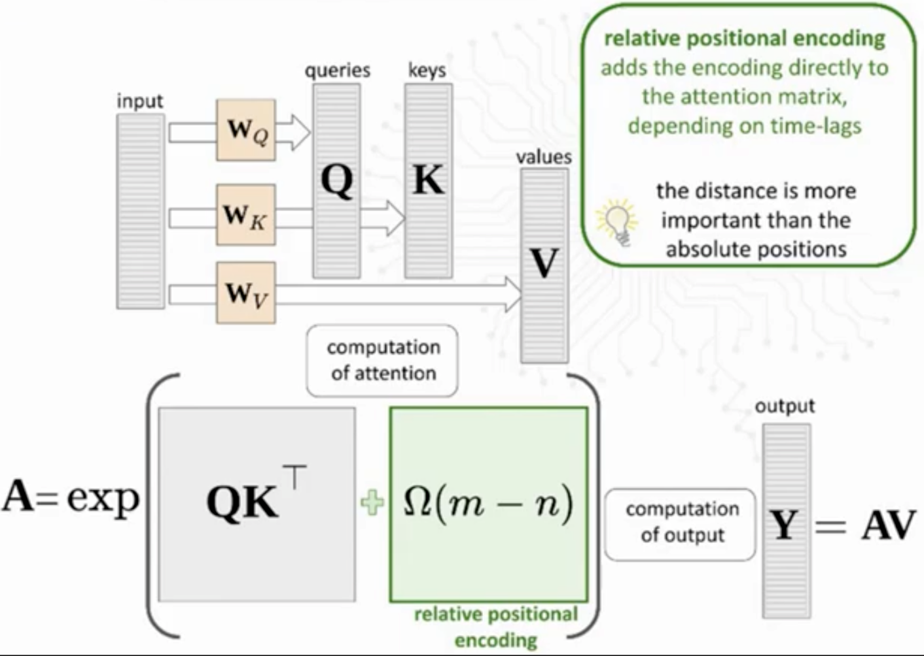
Transformer: Attention Mechanism
This is “self-attention” since Q, K, and V are all generated from the same sequence.
Notice this!

Slide 11
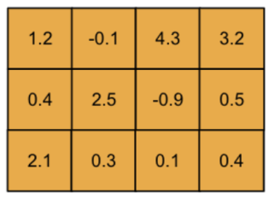
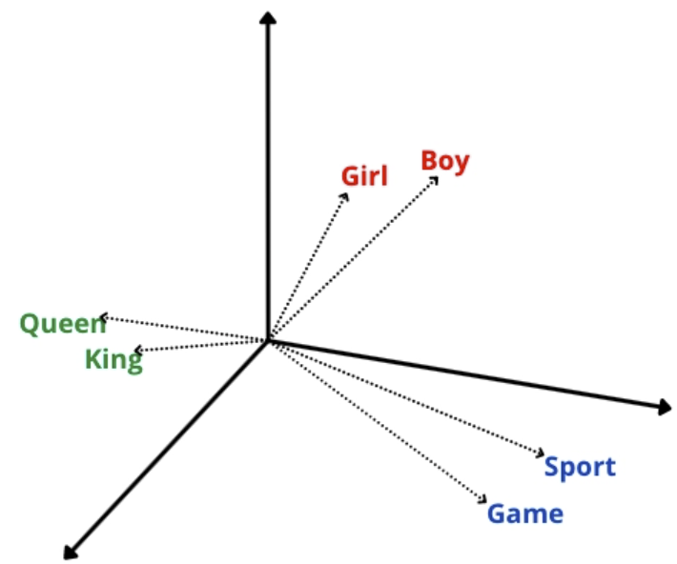
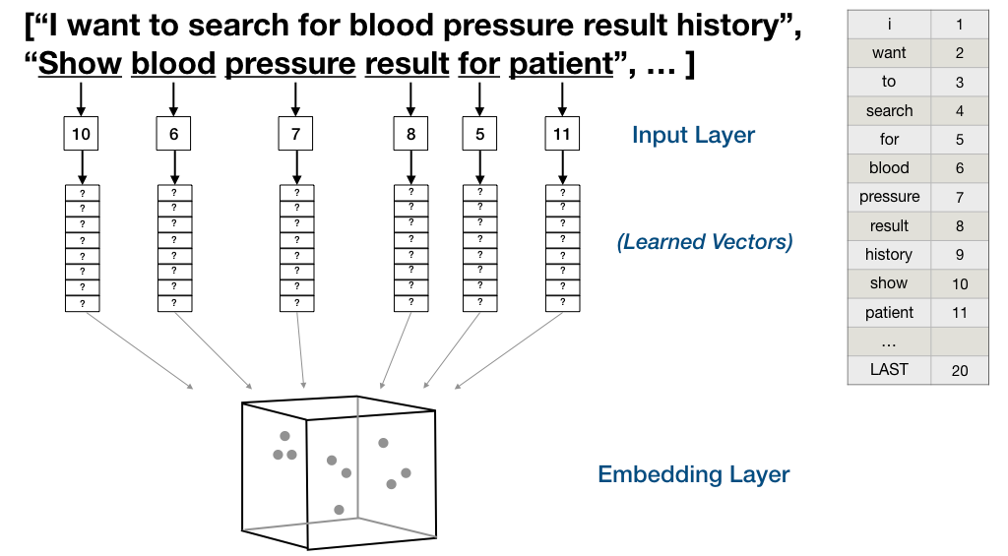
Encoding Layer: Word Encoding
Word Encoding:
Each word/token maps to a vector in a D-dimensional space using a previously learned dictionary.
Semantic dependency
Word embedding space
Embedding
a₁= Girl
a₂= Game
a₃= Queen
True ONLY for nearby samples!
Encoding a sentence:

Slide 12
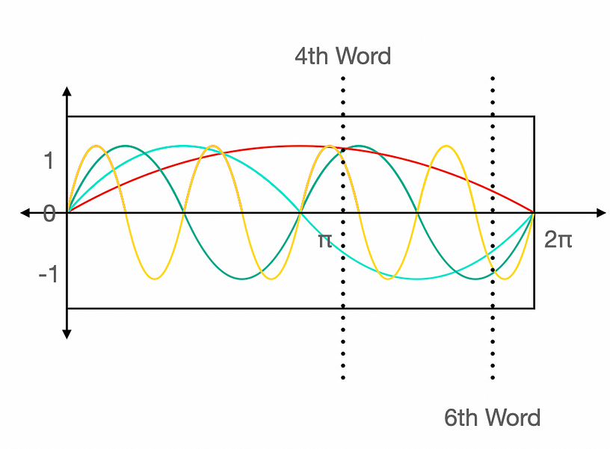
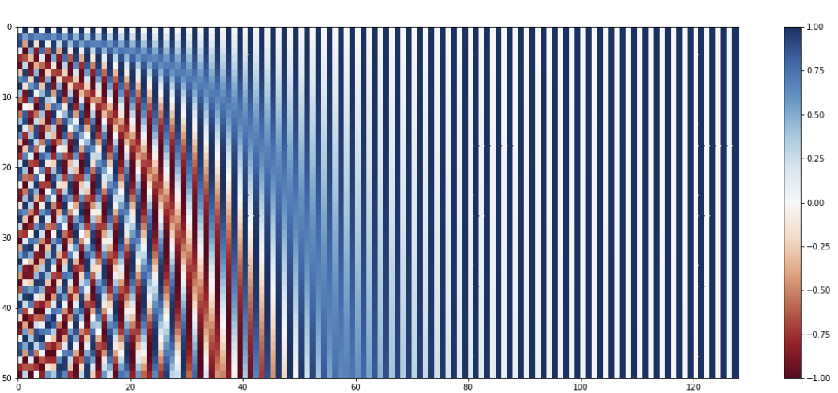
Encoding Layer: Positional Encoding
Positional Encoding:
The position of a word/token in a sequence is represented as a D-dimensional vector of values related to a Discrete Fourier Transform.
pos, Position
k, Component of Embedding Dimension
Similar to Arithmetic Encoding but on the unit circle, S¹, instead of the bounded interval [0,1] …

Slide 13
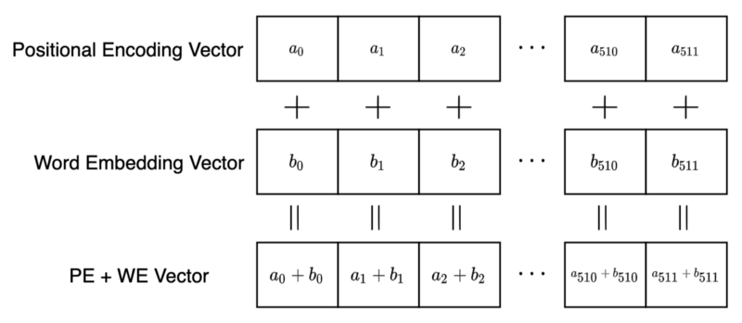
Encoding Layer: The Miracula Summa
The dimensionality of the word encoding is the same as the positional encoding!
ADD
THEM TOGETHER!

Slide 14
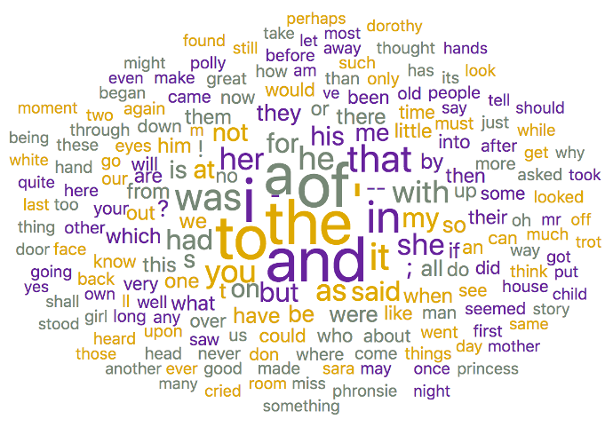
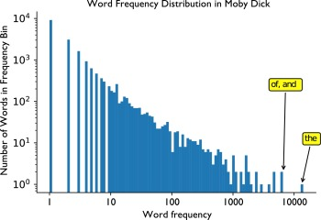
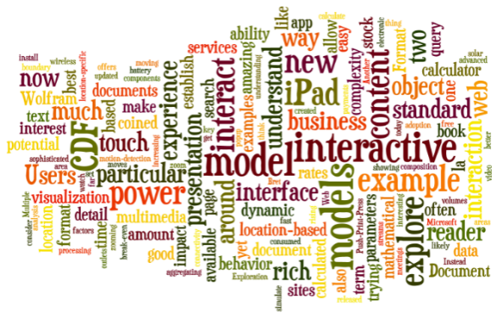
Dynamic “Clouds” around semantic anchor points
What are the geometric implications of ADDING the WORD and POSITION embeddings?
General language context
Word + Position embedding space
Training:
Frequency Distribution of Words
10⁵ Words
Special Interest context
Question: Does the Attention Mechanism induce spatially-dependent dynamic Affine Transformations on the Embedding Space?

Slide 15
Extra slides

Slide 16
Attention: Query, Keys, Values … and Causality?
The Attention mechanism embodies the structured retrieval of information seen in databases by:
Utilizing a query to represent the current focus or the information needed to generate the next element in the sequence.
Employing keys to index or identify relevant parts of the input sequence that could inform the generation of the next element.
Aggregating values based on the relevance determined through the interaction of query and keys, effectively retrieving the necessary information to construct the output.
The Masked Self-Attention mechanism, dynamically and adaptively "queries" the sequence itself, using the "database" of previous tokens (organized through keys and values) to inform the generation of the sequence in an autoregressive manner. The causal masking ensures that this retrieval process respects the sequential order, akin to an autoregressive model that bases predictions on past observations.

Slide 17
Different Attention Mechanisms
Self-Attention scores are like auto-correlations and Cross-Attention are cross-correlations of a sequence? This not quite, true since the Attention Scores matrix is not symmetric while the Auto-correlation matrix is!
Are they related to the Hankel matrix from Dynamical Systems Identification?
Self-Attention (Single Head):
Self-Attention (Multi-Head):
Cross-Attention (Single-Head):
Cross-Attention (Multi-Head):

Slide 18
Auto-Regressive (AR) Models

Slide 19
Understanding what to pay attention to …
Auto-correlation matrix
Hankel matrix
Attention Score matrix

